Slide 1

Big Questions in
Science and Religion
Samford University
Center for Science and Religion

Slide 2
Can There be Purpose in a World of Chance?
Big Questions in Science and Religion
Samford University Center for Science and Religion

Slide 3
Overview
Chance imbues contemporary culture
Chance is fundamental to many scientific theories
Atheists and believers alike view chance as a blow to religion
Chance has become a favored weapon for those seeing science and religion in conflict
Chance as the ignorance of causes
Order out of chaos
Chaos out of order
Do humans use chance in purposeful ways?
Might God use chance to achieve his purposes?
Some possible Christian responses

Slide 4
Premise 1
Chance is an integral part of life and contemporary culture.

Slide 5

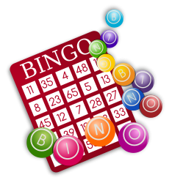

Gaming
US gaming revenues will increase to over $68 billion in 2014
(PricewaterhouseCoopers, LLC: http://www.pwc.com/us/en/press-releases/2010/us-gaming-revenues.jhtml)
43 states and the District of Columbia have lotteries
(http://www.us-lotteries.com/)
Casino gambling is legal in part or all of 42 states
(http://www.americancasinoguide.com/casinos-by-state)
Graphics with permission of Microsoft

Slide 6


Theater
Hapgood by Tom Stoppard
Copenhagen by Michael Frayn
Movies
No Country for Old Men: “What’s the most you ever lost on a coin toss?”
The Hunger Games: “…may the odds be ever in your favor.”
Batman – The Dark Knight: “In a cruel world the only morality is chance.”
The Butterfly Effect (chaos theory)
Run Lola Run
Graphics with permission of Microsoft

Slide 7
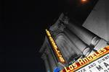
Movies
“You thought we could be decent men at an indecent time. But you were wrong; the world is cruel, and the only morality in a cruel world is chance. Unbiased. Unprejudiced. Fair.”
Two-Face in The Dark Knight Batman movie (2008)
Photo with permission of Microsoft

Slide 8
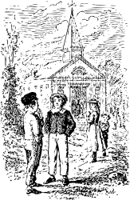
Literature
Middlemarch
by George Eliot
Chance
by Joseph Conrad
Graphics with permission of Microsoft

Slide 9


Television
Numb3rs (CBS)
Charlie: There's something else that
has to be considered.
Don: Like what?
Charlie: Heisenberg's uncertainty principle.
The X-Files (Fox)
Scully: Since when did you get a waterbed?
Mulder: I might just as easily not have a waterbed then I'd be on time for this meeting. You might just as easily have stayed in medicine and not gone into the FBI, and then we would never have met. Blah, blah, blah...
Scully: Fate.
Mulder: Free will. With every choice, you change your fate.
Touch (Fox)
  Various episodes
Perception (TNT)
Season 1, Episode 5, The Messenger
Graphic and photo with permission of Microsoft

Slide 10
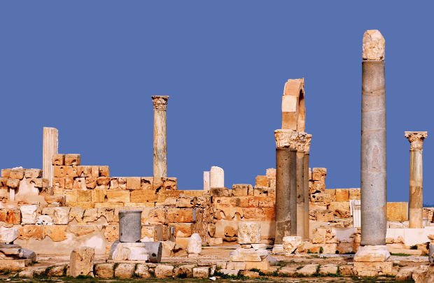
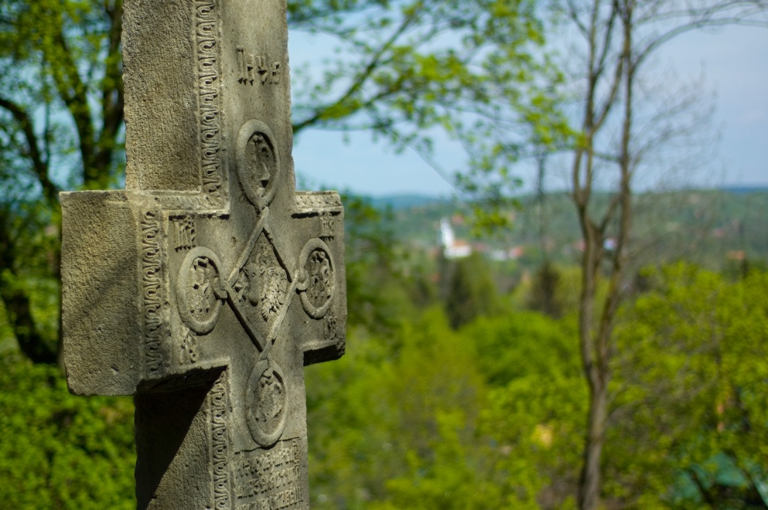
History
For Want of a Horse: Choice & Chance in History by John M. Merriman (ed.)
The Hinge Factor: How Chance and Stupidity Have Changed History
by Erik Durschmied
Graphics with permission of Microsoft

Slide 11

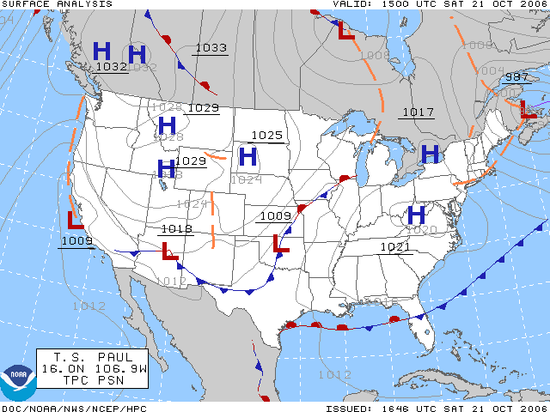
Weather Forecasting
High 79° F
Graphic with permission of Microsoft
Partly cloudy with occasional rain showers.
Winds light and variable.
Chance of rain 50%.
http://commons.wikimedia.org/wiki/File:Surface_analysis.gif

Slide 12

The iPod Shuffle!
Photo courtesy of Wikimedia Commons: http://commons.wikimedia.org/wiki/File:IPod_Shuffle_Crop.jpg

Slide 13
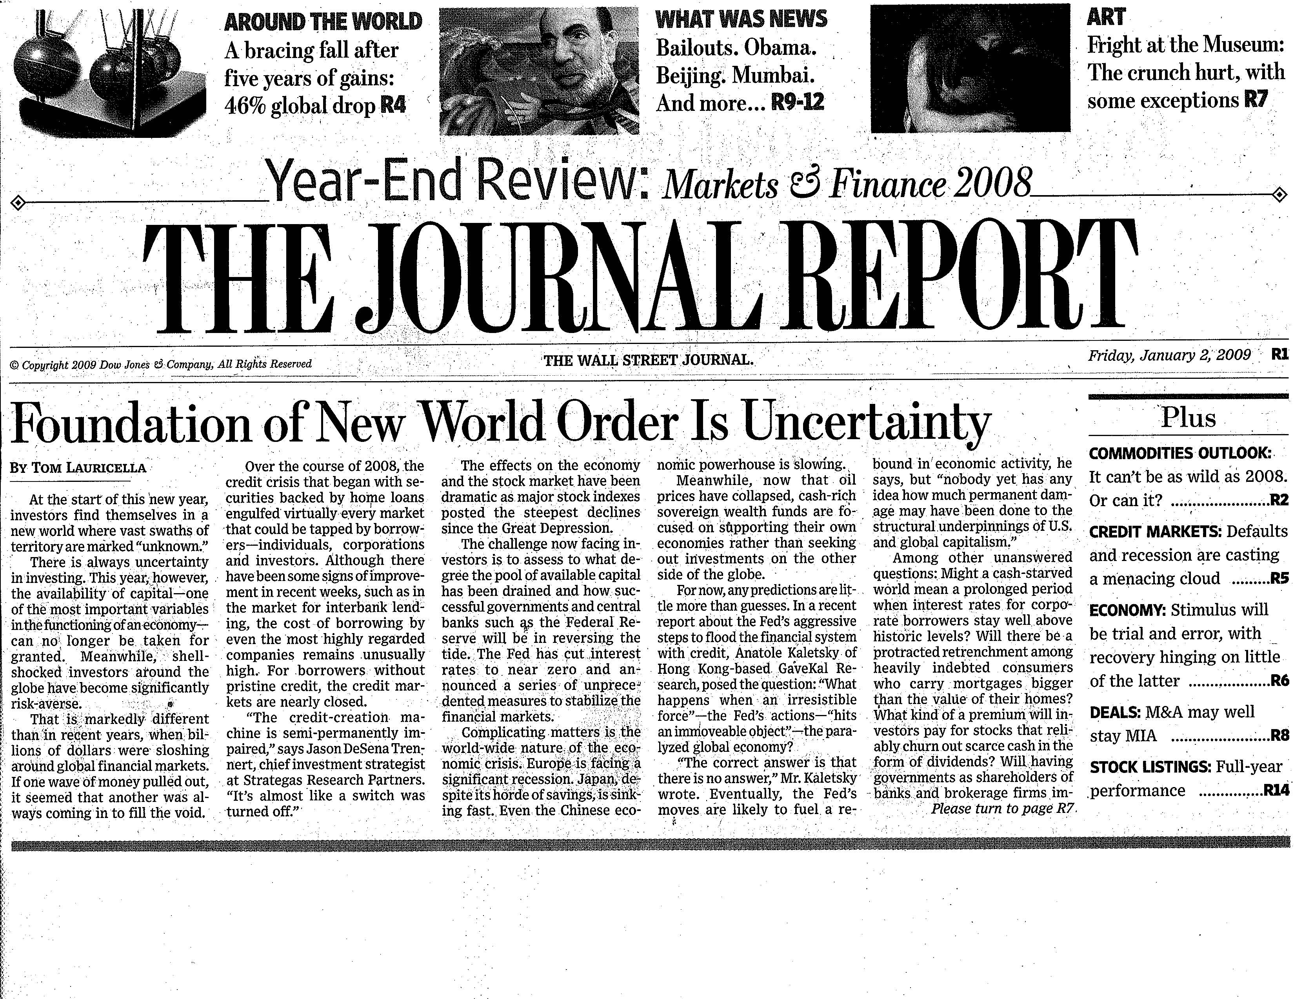

Slide 14
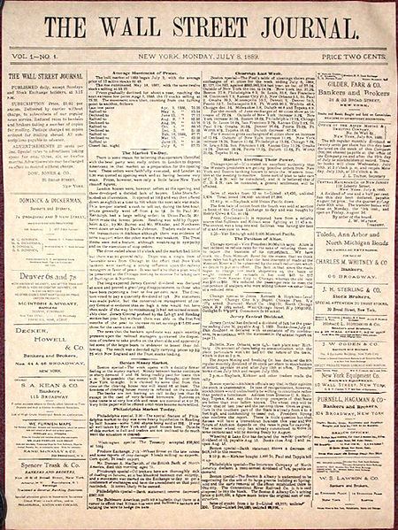
“Foundation of New World Order is Uncertainty”
Wall Street Journal headline, January 2, 2009, page R1
Photo courtesy of Wikimedia Commons: http://commons.wikimedia.org/wiki/File:The_Wall_Street_Journal_first_issue.jpg

Slide 15
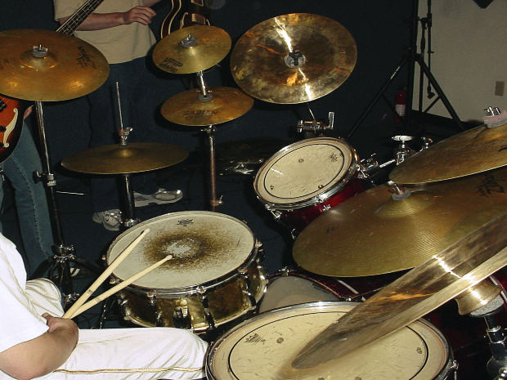
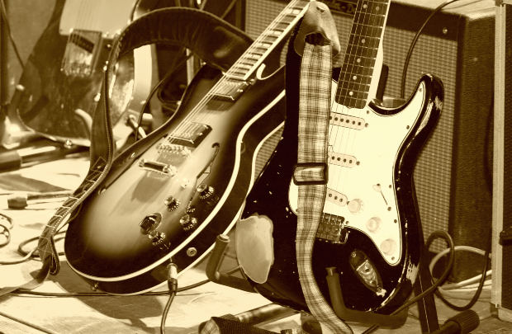
There are those who think that life has nothing left to chance,
A host of holy horrors to direct our aimless dance.
A planet of playthings,
We dance on the strings
Of powers we cannot perceive
"The stars aren't aligned -
Or the gods are malign"
Blame is better to give than receive.
You can choose a ready guide in some celestial voice.
If you choose not to decide, you still have made a choice.
You can choose from phantom fears and kindness that can kill;
I will choose a path that's clear-
I will choose Free Will.
Rock ‘n’ Roll
Rush’s Free Will
Photos with permission of Microsoft

Slide 16
Chance
lottery
fortune
randomness
luck
serendipity
accident
fate
uncertainty
probability
risk
coincidence
likelihood
odds
caprice
unpredictability
fluke
hazard

Slide 17
Premise 2
Chance is an integral part of
contemporary science.

Slide 18
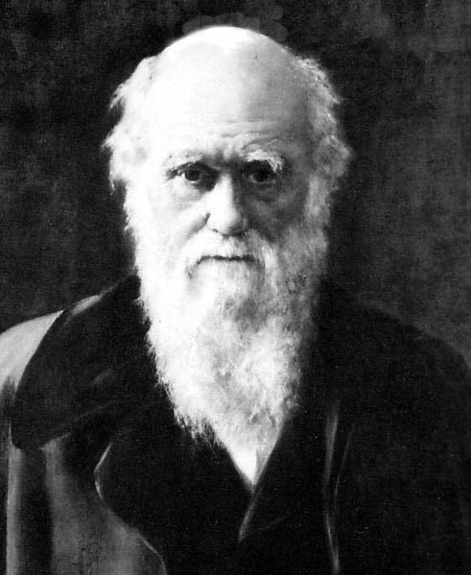
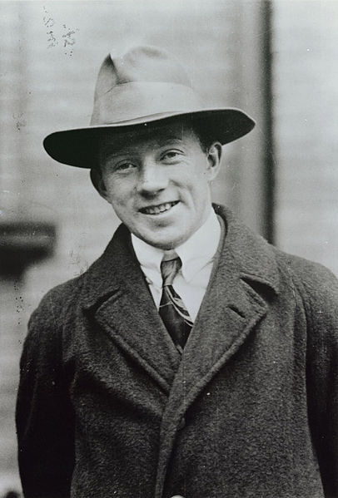
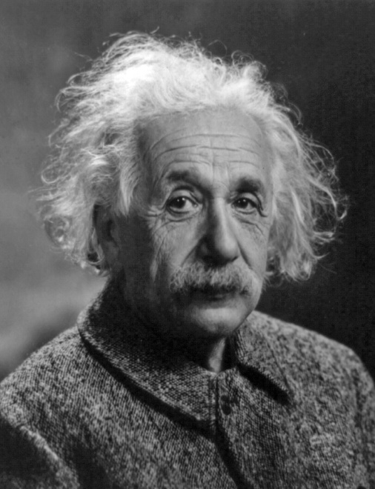
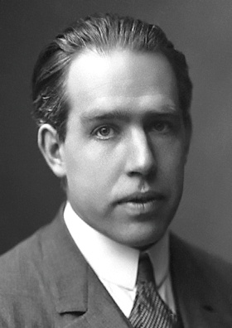
Darwin
Heisenberg
Courtesy of Wikimedia Commons: http://commons.wikimedia.org/wiki/File:Heisenberg_10.jpg
Courtesy of Wikimedia Commons: http://commons.wikimedia.org/wiki/File:Charles_Darwin_01.jpg
Courtesy of Wikimedia Commons: http://commons.wikimedia.org/wiki/Albert_Einstein
Einstein
Bohr
Courtesy of Wikimedia Commons: http://commons.wikimedia.org/wiki/Niels_Bohr

Slide 19
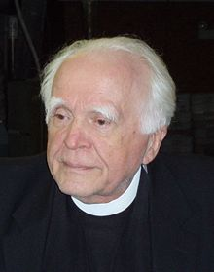
Physicist, Jesuit priest
Fr. Stanley Jaki
“…during the half a dozen years that followed the enunciation by Heisenberg of the principle of uncertainty, almost immediately a drastic meaning was grafted on it, a meaning thoroughly philosophical… reality’s place was taken by chance, not the chance that stands for ignorance, but which stands for a philosophical ghost residing in the shadowy realm between being and non-being.“
Jaki, Stanley (1986). Chance or Reality and Other Essays. Lanham, MD: University Press of America.
Photo courtesy of Wikimedia Commons: http://commons.wikimedia.org/wiki/Stanley_Jaki
Notes:
Not until the ‘50’s and the work of evolutionary geneticists and their discoveries about the genetic code that the full measure of the threat to religious belief became apparent.
Monod delivered the seemingly mortal blow… Geneticist and biochemist; 1965 winner of the Nobel Prize for early in molecular genetics and replication of DNA
“Chance and Necessity”: 1970 - French, 1971 - English

Slide 20
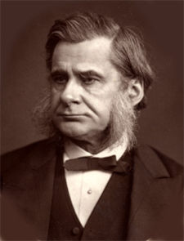
Darwin’s
Bulldog
T. H. Huxley
“Do they believe that anything in this universe happens without reason or without a cause? Do they really conceive that any event has no cause, and could not have been predicted by any one who had sufficient insight into the order of Nature?“
Darwin, F., ed. (1959). The Life and Letters of Charles Darwin. NY: Basic Books.
Photo courtesy of Wikimedia Commons: http://commons.wikimedia.org/w/index.php?search=T.+H.+Huxley&title=Special%3ASearch
Notes:
Not until the ‘50’s and the work of evolutionary geneticists and their discoveries about the genetic code that the full measure of the threat to religious belief became apparent.
Monod delivered the seemingly mortal blow… Geneticist and biochemist; 1965 winner of the Nobel Prize for early in molecular genetics and replication of DNA
“Chance and Necessity”: 1970 - French, 1971 - English

Slide 21
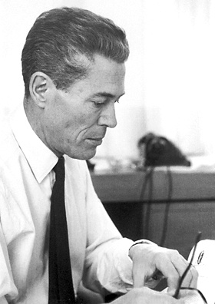
Biochemist, Nobel laureate
Jacques Monod
“We say that these events are accidental, due to chance. And since they constitute the only possible source of modifications in the genetic text, itself the sole repository of the organism’s hereditary structures, it necessarily follows that chance alone is at the source of every innovation, of all creation in the biosphere. Pure chance, absolutely free but blind, at the very root of the stupendous edifice of evolution: this central concept of modern biology is no longer one among other possible or even conceivable hypotheses. It is today the sole conceivable hypothesis, the only one compatible with observed and tested fact. And nothing warrants the supposition (or the hope) that conceptions about this should, or ever could, be revised.”
Monod, Jacques (1970). Chance and Necessity. New York: Alfred A. Knopf (p. 110).
Photo courtesy of Wikimedia Commons: http://commons.wikimedia.org/w/index.php?search=jacques+monod&button=&title=Special%3ASearch
Notes:
Not until the ‘50’s and the work of evolutionary geneticists and their discoveries about the genetic code that the full measure of the threat to religious belief became apparent.
Monod delivered the seemingly mortal blow… Geneticist and biochemist; 1965 winner of the Nobel Prize for early in molecular genetics and replication of DNA
“Chance and Necessity”: 1970 - French, 1971 - English

Slide 22
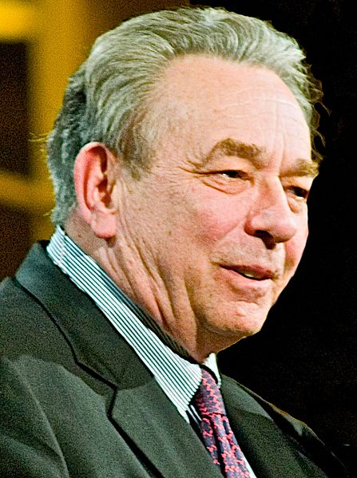
Calvinist theologian, pastor
R. C. Sproul
“It is my purpose to show that it is logically impossible to ascribe any power to chance whatever… If chance exists in its frailest possible form, God is finished… If chance exists in any size, shape or form, God cannot exist.”
Sproul, R.C. (1994). Not a Chance: The Myth of Chance in Science & Cosmology. Grand Rapids, MI: Baker Books (p. 3).
Courtesy of Wikimedia Commons: http://commons.wikimedia.org/w/index.php?search=r.+c.+sproul&title=Special%3ASearch

Slide 23
Premise 3
Chance is a major weapon of those who regard science and theology as locked in combat.

Slide 24
Sproul’s theology Monod’s science
Can we bridge the theology and the science?
Is Sproul correct that chance is a threat to God’s sovereignty?
Is Monod correct that chance eliminates the need for God?
Is chance the antithesis of purpose?
Bridge graphic used with permission from Microsoft

Slide 25
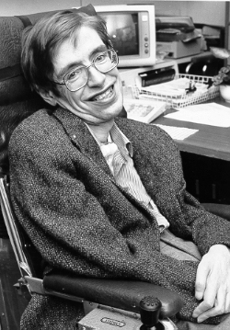
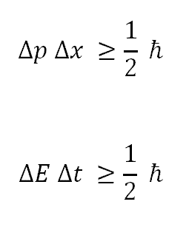

A Brief History of Chance
Antiquity (causal)
Chance Worldview
Post-modernity (acausal)
Christian
Worldview
(causal)
Scientific
Worldview
(causal)
All graphics/images with permission of Microsoft
Photo of Stephen Hawking courtesy of Wikimedia Commons: http://commons.wikimedia.org/wiki/Stephen_Hawking

Slide 26
What is Chance?
“the absence of any cause of events that can be predicted, understood, or controlled” ¹
(i.e., chance is not a causal agent)
“the intersection of two or more lines of causality that are independent of each other, in a way that is accidental and unintended by the agents involved” ²
¹ Dictionary.com
² Baglow, CT (2009). Faith, Science & Reason: Theology on the Cutting Edge. Woodridge, IL: Midwest Theological Forum.

Slide 27
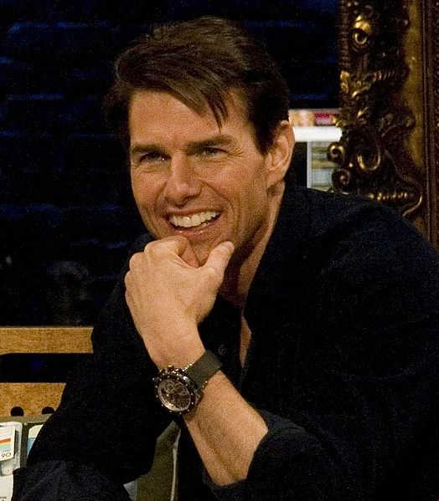
Chance as the Ignorance of Causes
Movie: Valkyrie
Tom Cruise
Historical contingency / accident
Photo courtesy of Wikimedia Commons: http://commons.wikimedia.org/wiki/File:TomCruiseDec08MTVwatch.jpg

Slide 28

Chance as the Ignorance of Causes
Persi Diaconis’ Coin Flipping Machine
Photo used with permission of Susan Holmes and National Public Radio

Slide 29

Chance as the Absence of Causes
Alpha particle
Radioactive decay
Image of atom with permission of Microsoft

Slide 30
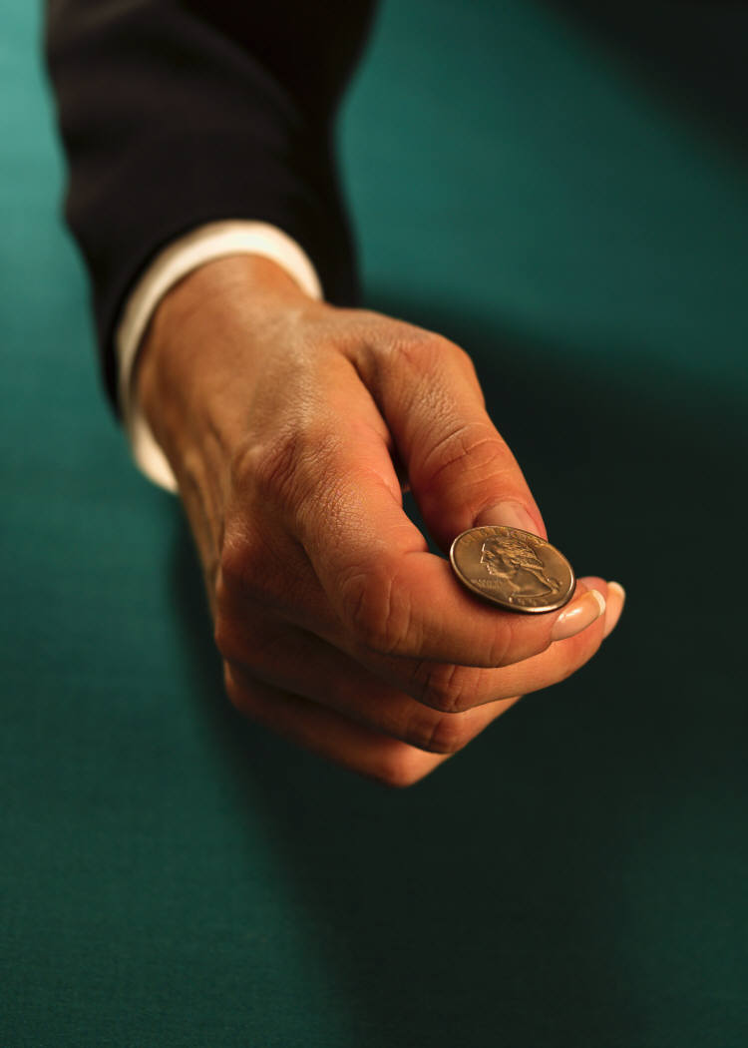
Order Emerging From Chance
(statistical laws)
Images with permission of Microsoft

Slide 31
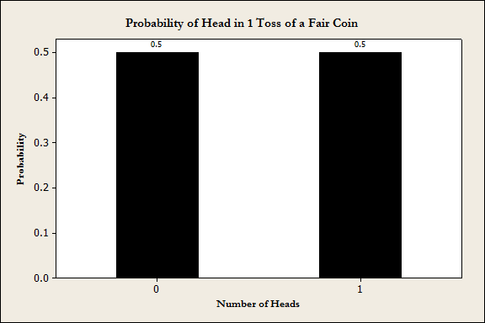
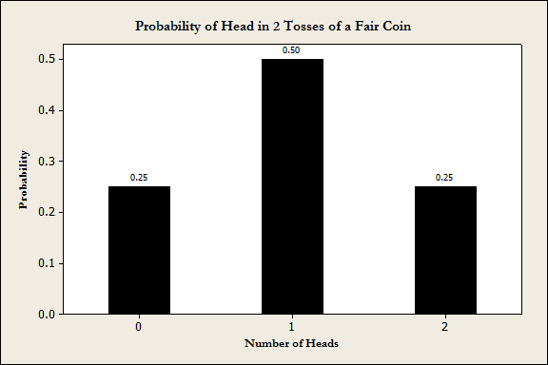
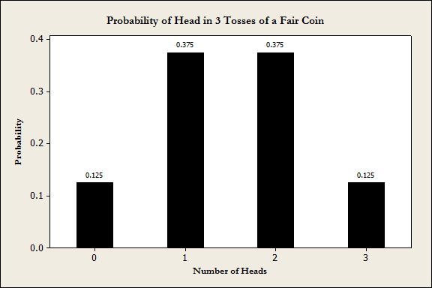
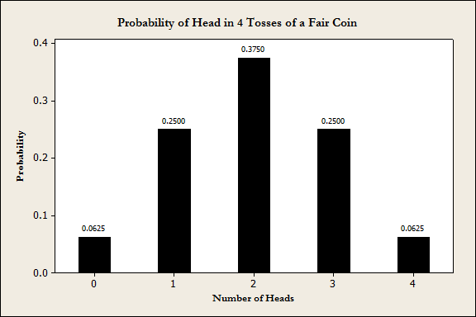
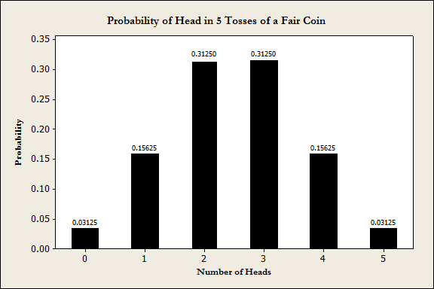
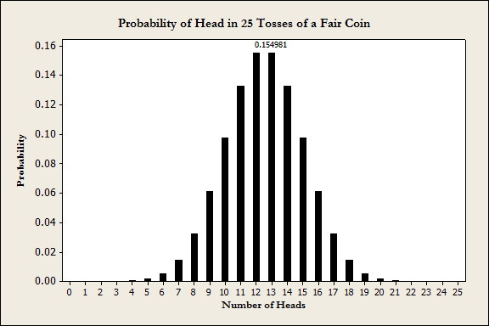

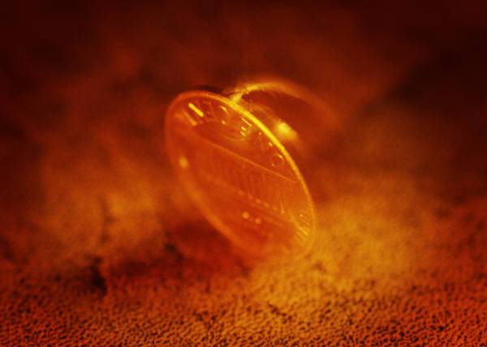
Order Emerging From Chance (statistical laws)
Photos with permission of Microsoft

Slide 32
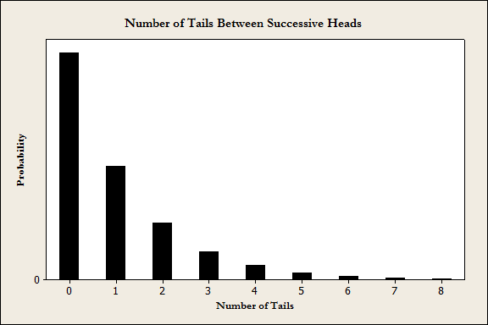
Order Emerging From Chance (statistical laws)
HTTHTTTHHTTTHHH…

Slide 33
Order Out of Chaos (statistical laws)
HTTH TTTH HTTT THHH…

Slide 34
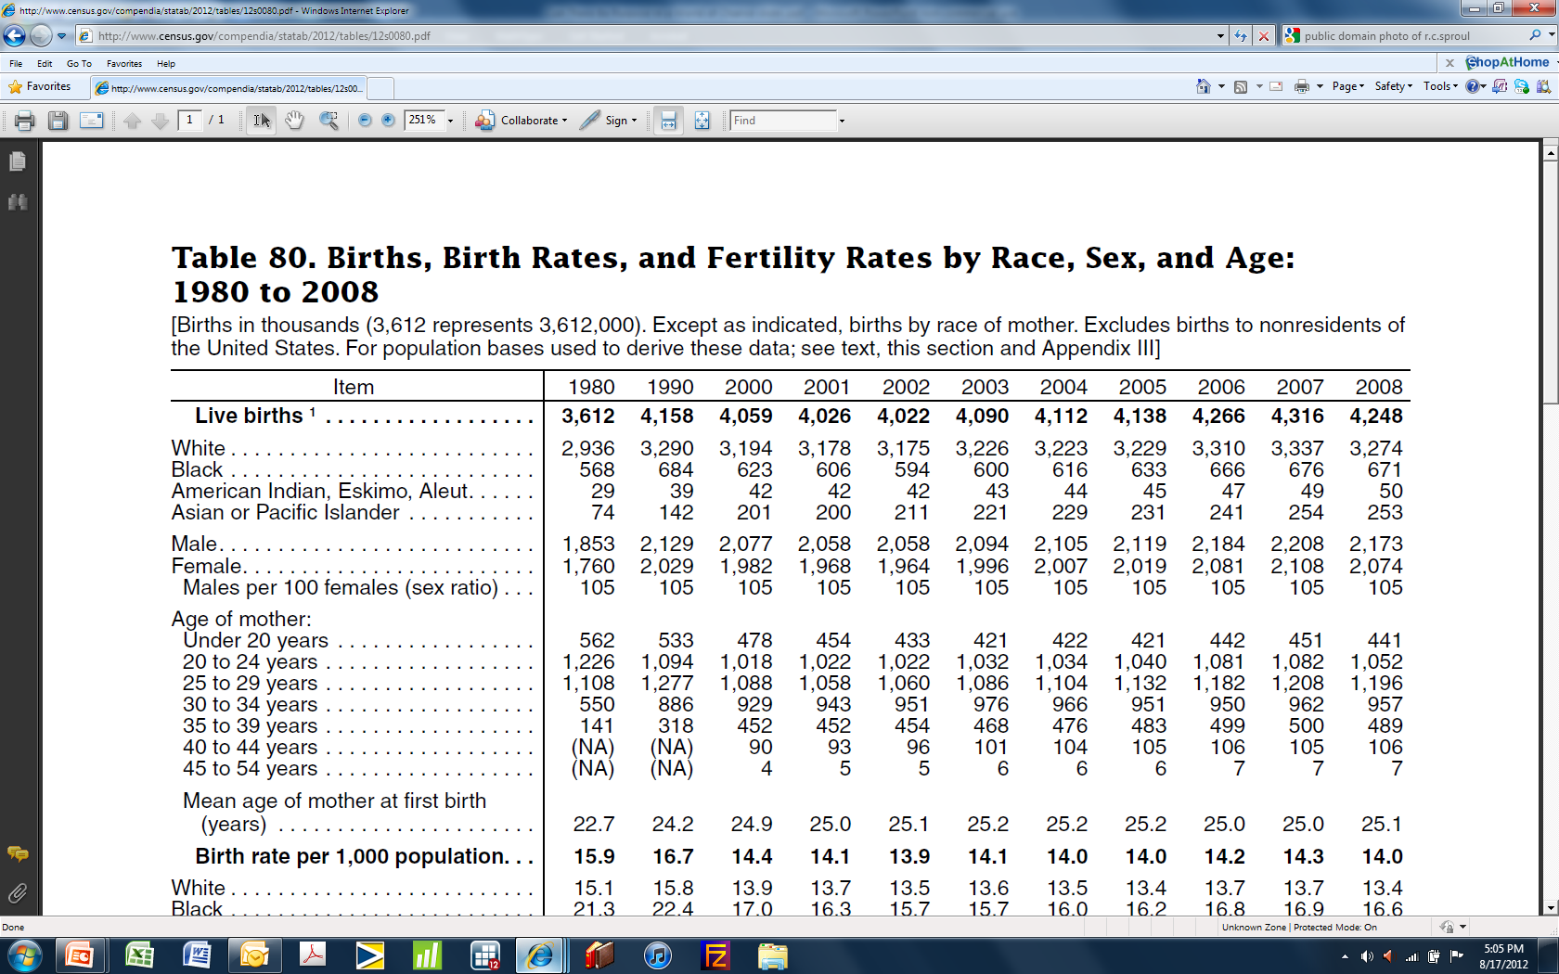
Order Emerging From Chance (statistical laws)
What is the probability of having a male baby?
Source: http://www.census.gov/compendia/statab/2012/tables/12s0080.pdf

Slide 35
Chance or Purpose?
Is chance the antithesis of purpose?
Chance and Purpose?
Does order in creation emerge from underlying chance?
Is chance a precondition for the order in creation which speaks so eloquently of the divine mind?
Maybe it’s not either/or but both/and…

Slide 36
Can there be purpose in a world of chance?

Slide 37

Chance Emerging From Order
Accidents / coincidences
Pseudo-random numbers
Chaos theory
Photo/images with permission of Microsoft

Slide 38
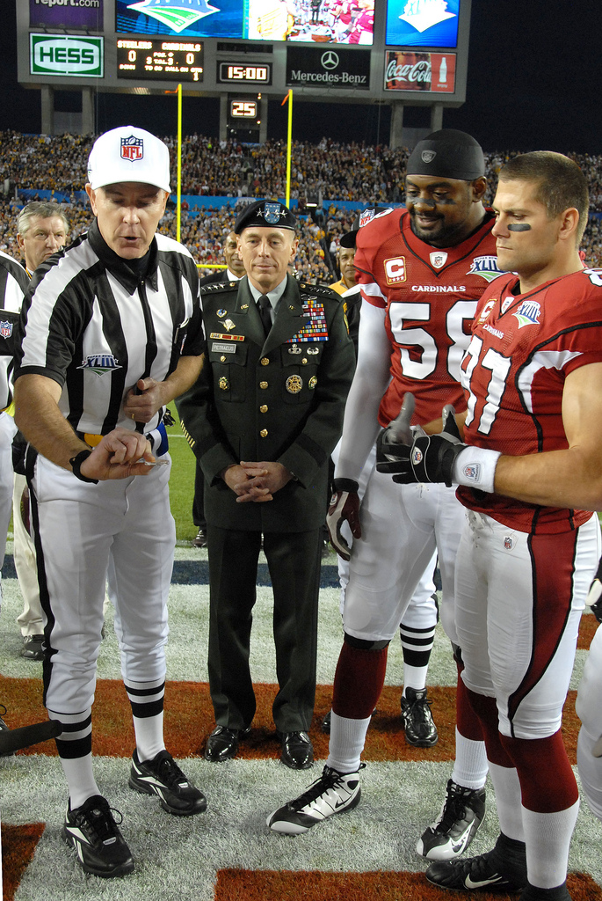
Why do we start a game with a coin toss?
Super Bowl XLIII coin toss (2/1/2009), Raymond James Stadium in Tampa, Florida. USAF Photo by SSgt Bradley Lail (public domain).

Slide 39
Human Uses of Chance
coin tosses to start games
excitement, unpredictability in games
solving mathematical problems with Monte Carlo simulations
‘random’ chemistry to generate candidate molecules for drug development
sampling in polls and research
the arts - Mozart’s Musikalisches Würfelspiel 32 bars; a 16- bar minuet & a 16-bar trio to be selected from 176 bars by rolling dice, http://sunsite.univie.ac.at/Mozart/dice/
    game theory – John Nash, A Beautiful Mind
    a spray painter!

Slide 40
Might God use chance to achieve a purpose?

Slide 41
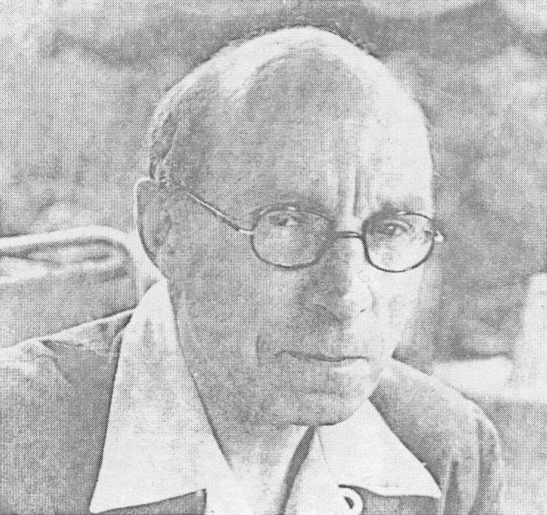
Might God use chance to achieve a purpose?
“[f]or the rational purpose of ensuring fair play we create conditions in which decisions shall be left to chance; for the furtherance of His purpose in creation God gives to His universe a mode of reality which admits of the existence and occurrence of such irrationalities as contingency, freedom and evil.”
Leonard Hodgson (1968). For Faith and Freedom: The Gifford Lectures, 1955-1957 in the University of Glasgow, Volume I, London: SCM Press Ltd.
Photo courtesy of Fisher Humphreys

Slide 42
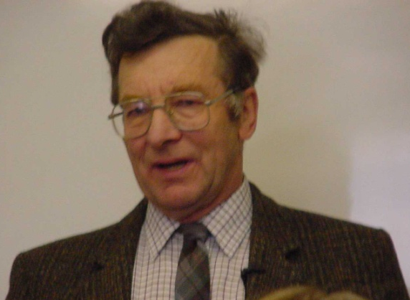
Some Possible Christian Responses
Open Theism
God inside time/space
God wills necessarily or not at all (foreknowledge implies determinism)
God is
  * passible
  * mutable
  * omnipotent
  * with limited omniscience
David Bartholomew
Leonard Hodgson
Photo courtesy of Fisher Humphreys

Slide 43
Some Possible Christian Responses
Simple Foreknowledge
God has utterly complete knowledge of the future “…uncomplicated by exceptions, additions, qualifications, et cetera…”
Hunt, D. (2001). Divine Foreknowledge: Four Views. Downer’s Grove,
IL: IVP, p. 67.
Not based on God's pre-determining of all
events, but on His ability to "see" the future
God has chosen to give His creatures
  free-will, but He can see what choices
  they will make before time begins
As such, randomness is independent
of God’s foreknowledge.
Image with permission of Microsoft

Slide 44
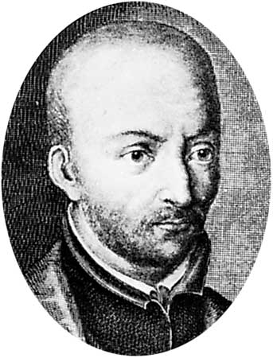
Some Possible Christian Responses
Molinism
Luis de Molina
Natural knowledge: all possible worlds God could create
Free knowledge: God’s knowledge “after” choosing our world
Middle knowledge: in-between natural & free knowledge, knowledge of events (some random) in all possible worlds
By knowing all possible worlds, God chose this one knowingly creating randomness, foreknow its outcomes & guarantee that his will is achieved
As such, randomness becomes part of God’s plan to fulfill his will
Sources: Bradley, J. (2012). Randomness and God’s Nature. PSCF, 64(2): 75-89 & Miller, M.R. (2000). In Defense of the Reconciliation of Divine Will and Human Freedom According to St. Thomas Aquinas. Doctoral dissertation, Boston College.
Drawing courtesy of Wikimedia Commons: http://commons.wikimedia.org/wiki/Luis_de_Molina

Slide 45
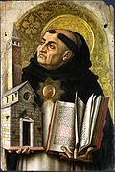

Some Possible Christian Responses
Aquinas (Classical)
Thomas Aquinas
God outside time/space
God wills necessarily and contingently (foreknowledge does not imply determinism)
God is
* impassible * immutable
* omnipotent * omniscient
Courtesy of Wikimedia Commons:
http://commons.wikimedia.org/wiki/File:St-thomas-aquinas.jpg

Slide 46
Discussion Questions
Does chance in creation deny divine Providence?
Is chance is a threat to God’s sovereignty?
If chance exists, must there be no purpose to creation?
Does chance eliminate the need for God?
What would a world without chance look like?

Slide 47
Can There be Purpose in a World of Chance?
Thomas W. Woolley, Ph.D.
Samford University
Conditions of Use
The slides contained in this presentation and the accompanying notes are freely available for use and/or modification by individuals and groups to promote understanding and dialogue in science and religion with the stipulation that they may not be sold or traded individually, collectively, or otherwise for any form of financial or material gain. The source of all images in this collection of slides is either noted directly (if required by the author) or may be viewed by clicking an image (in edit mode) and then clicking “Send to Back.” These forms of crediting images must be included in any use or derivation of these materials.
The contents of these slides and the accompanying notes reflect the views of the author and should not be assumed to represent the position of Samford University or its employees.

